Slide 1



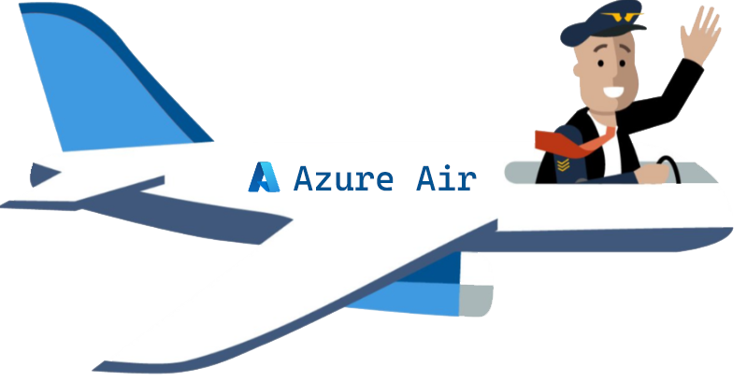
Tech Days 2021 Flight into IoT
Azure Time Series Insight
Sander van de Velde
IoT Solution Architect
Atos
MVP Azure IoT
@svelde

Slide 2










Flight into IoT System Diagram
Service Bus Queue
Logic
App
3rd Party Services
IoT Hub
Time Series Insights
Device Provisioning Service
Stream Analytics
Power BI
@svelde

Slide 3
Airplane data is arriving at the IoT Hub, what now?
Questions, Questions, Questions
From an Operator perspective
Can I get a sneak peak on telemetry currently arriving?
Can I compare telemetry of a specific flight, even from 15 years ago? Within seconds?
Etc.
From a Data Scientist perspective
I want to see if there is a certain trend in the data
I have a suspicion about the existence of certain anomalies that I would like to see confirmed
Etc.
@svelde

Slide 4





Azure Time Series Insights (TSI)
A fully managed (platform as a service - PaaS) solution built for IoT
Ingest, process, store, query, and visualize
highly contextualized, time-series-optimized, IoT data at scale
Connect to a variety of data solutions
using TSI’s flexible data platform
Use rich analytics APIs and UX
for ad-hoc exploration and operational intelligence
Use JavaScript SDK
for building custom analytics apps on the TSI platform
@svelde
Notes:
we need an Operational Historian in the cloud

Slide 5



Azure Time Series Insights pay-as-you-go high-level architecture
Ingest
Store
Model
Analyze
</>
COLD STORE ADLS Gen 2/ Azure Blob
Azure Event
Hub
Time Series Model
Time Series Query API
Time Series Insights Explorer
Power BI Connector
3rd PARTY APPS
Azure IoT
Hub
Azure Digital Twins
Ingestion processing
WARM STORE ADX
</>
TSM Update API
Timeseries data
API requests/returns
AI/ML workflow
@svelde

Slide 6

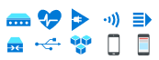


Uncovering the why:
Anomaly detection and diagnosis
3rd Party IoT apps using Time Series Insights APIs
Query API
Time Series Insights JavaScript SDK
IoT device, gateway, and application data
Azure IoT Hub
Time Series Insights
Time Series Insights Explorer
@svelde

Slide 7
Demo Time Series Insights
@svelde

Slide 8
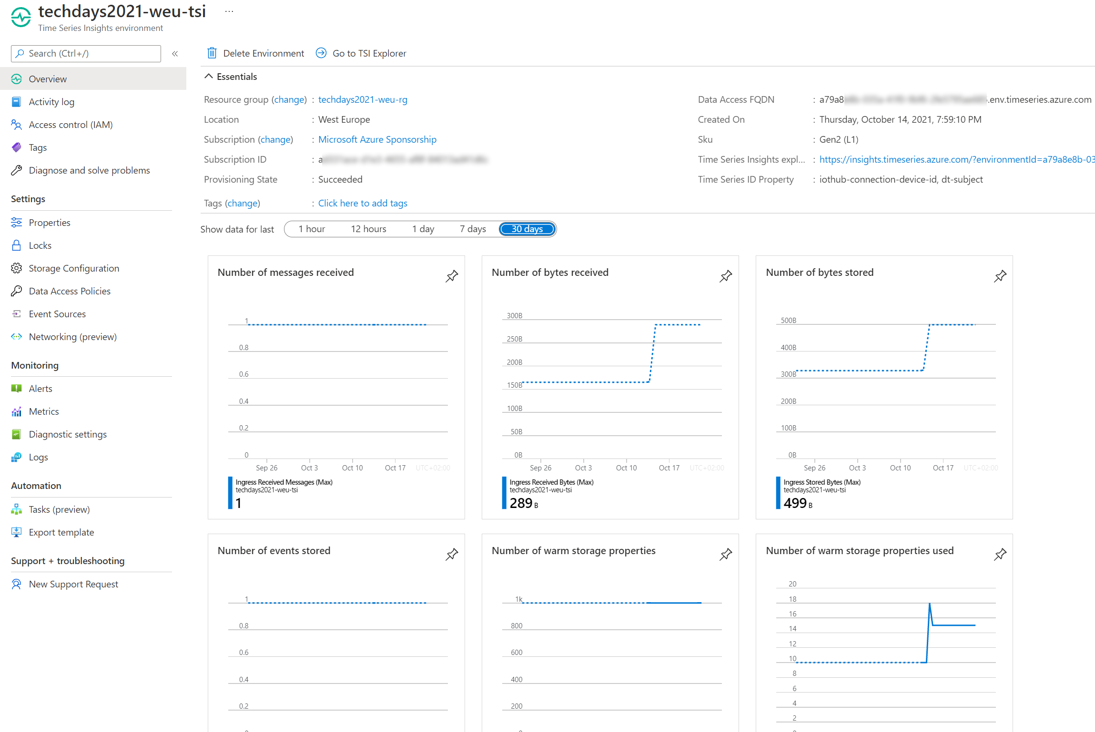
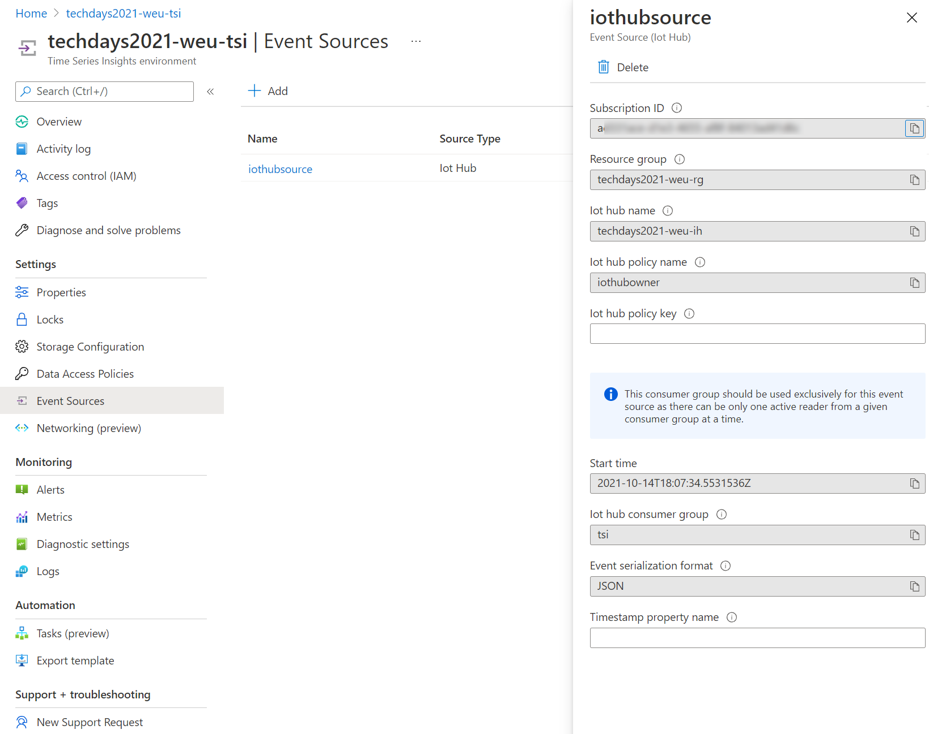
Demo
@svelde

Slide 9
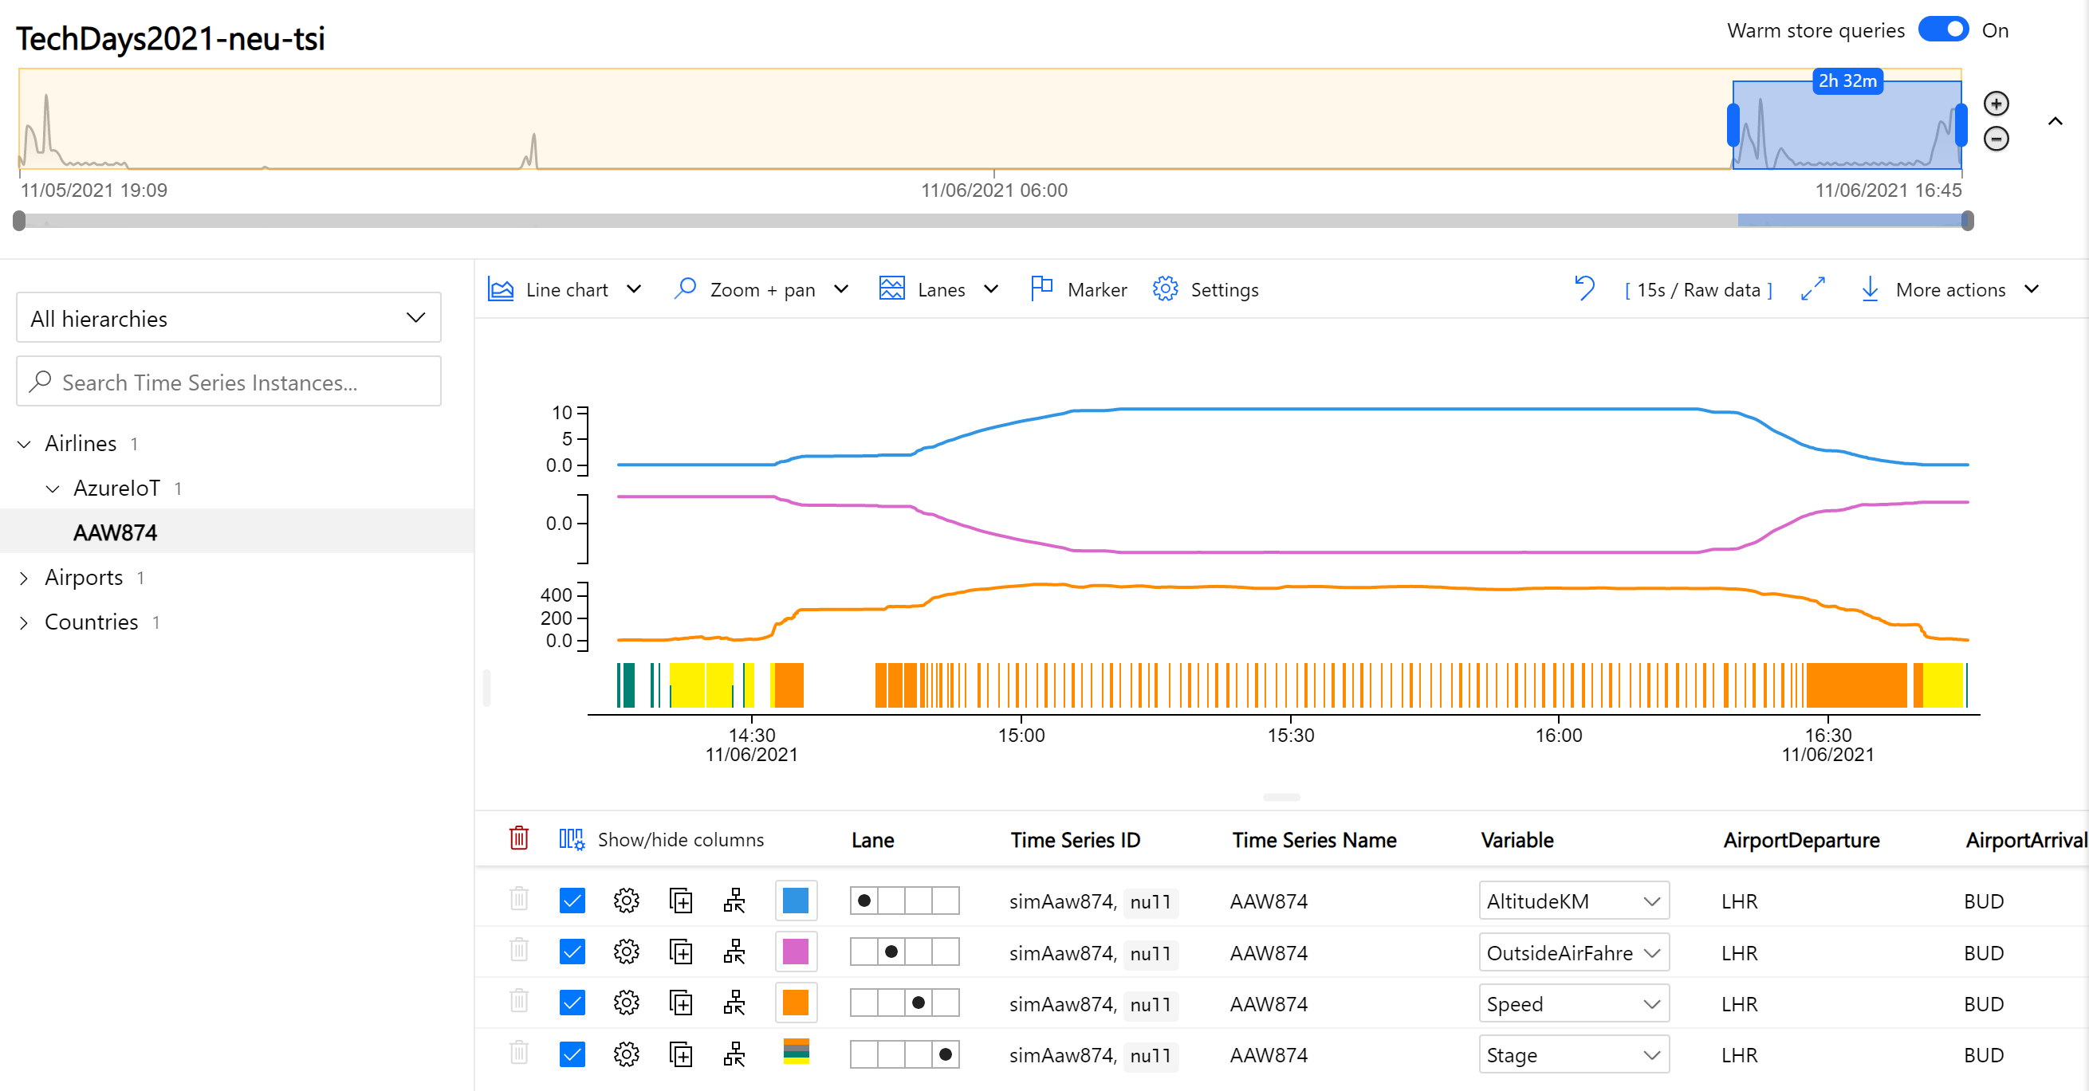
Demo
@svelde

Slide 10
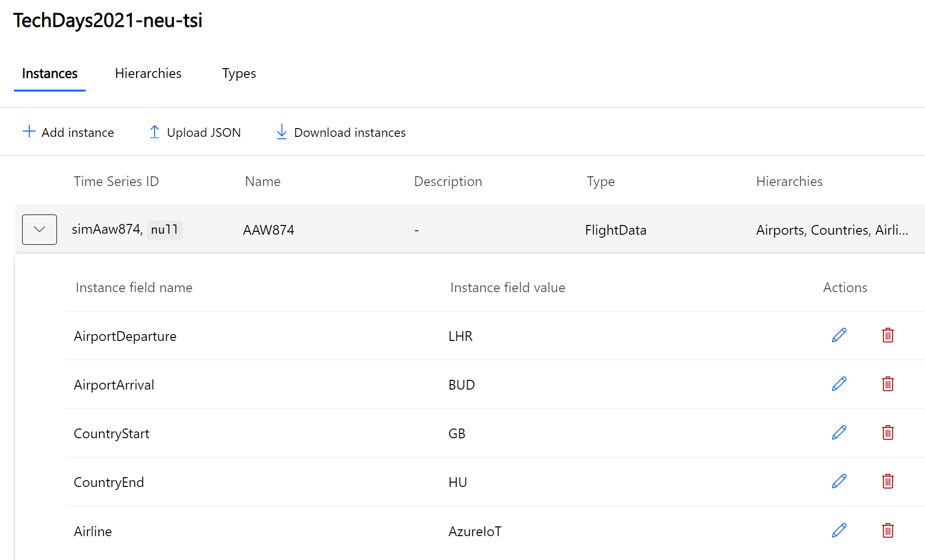
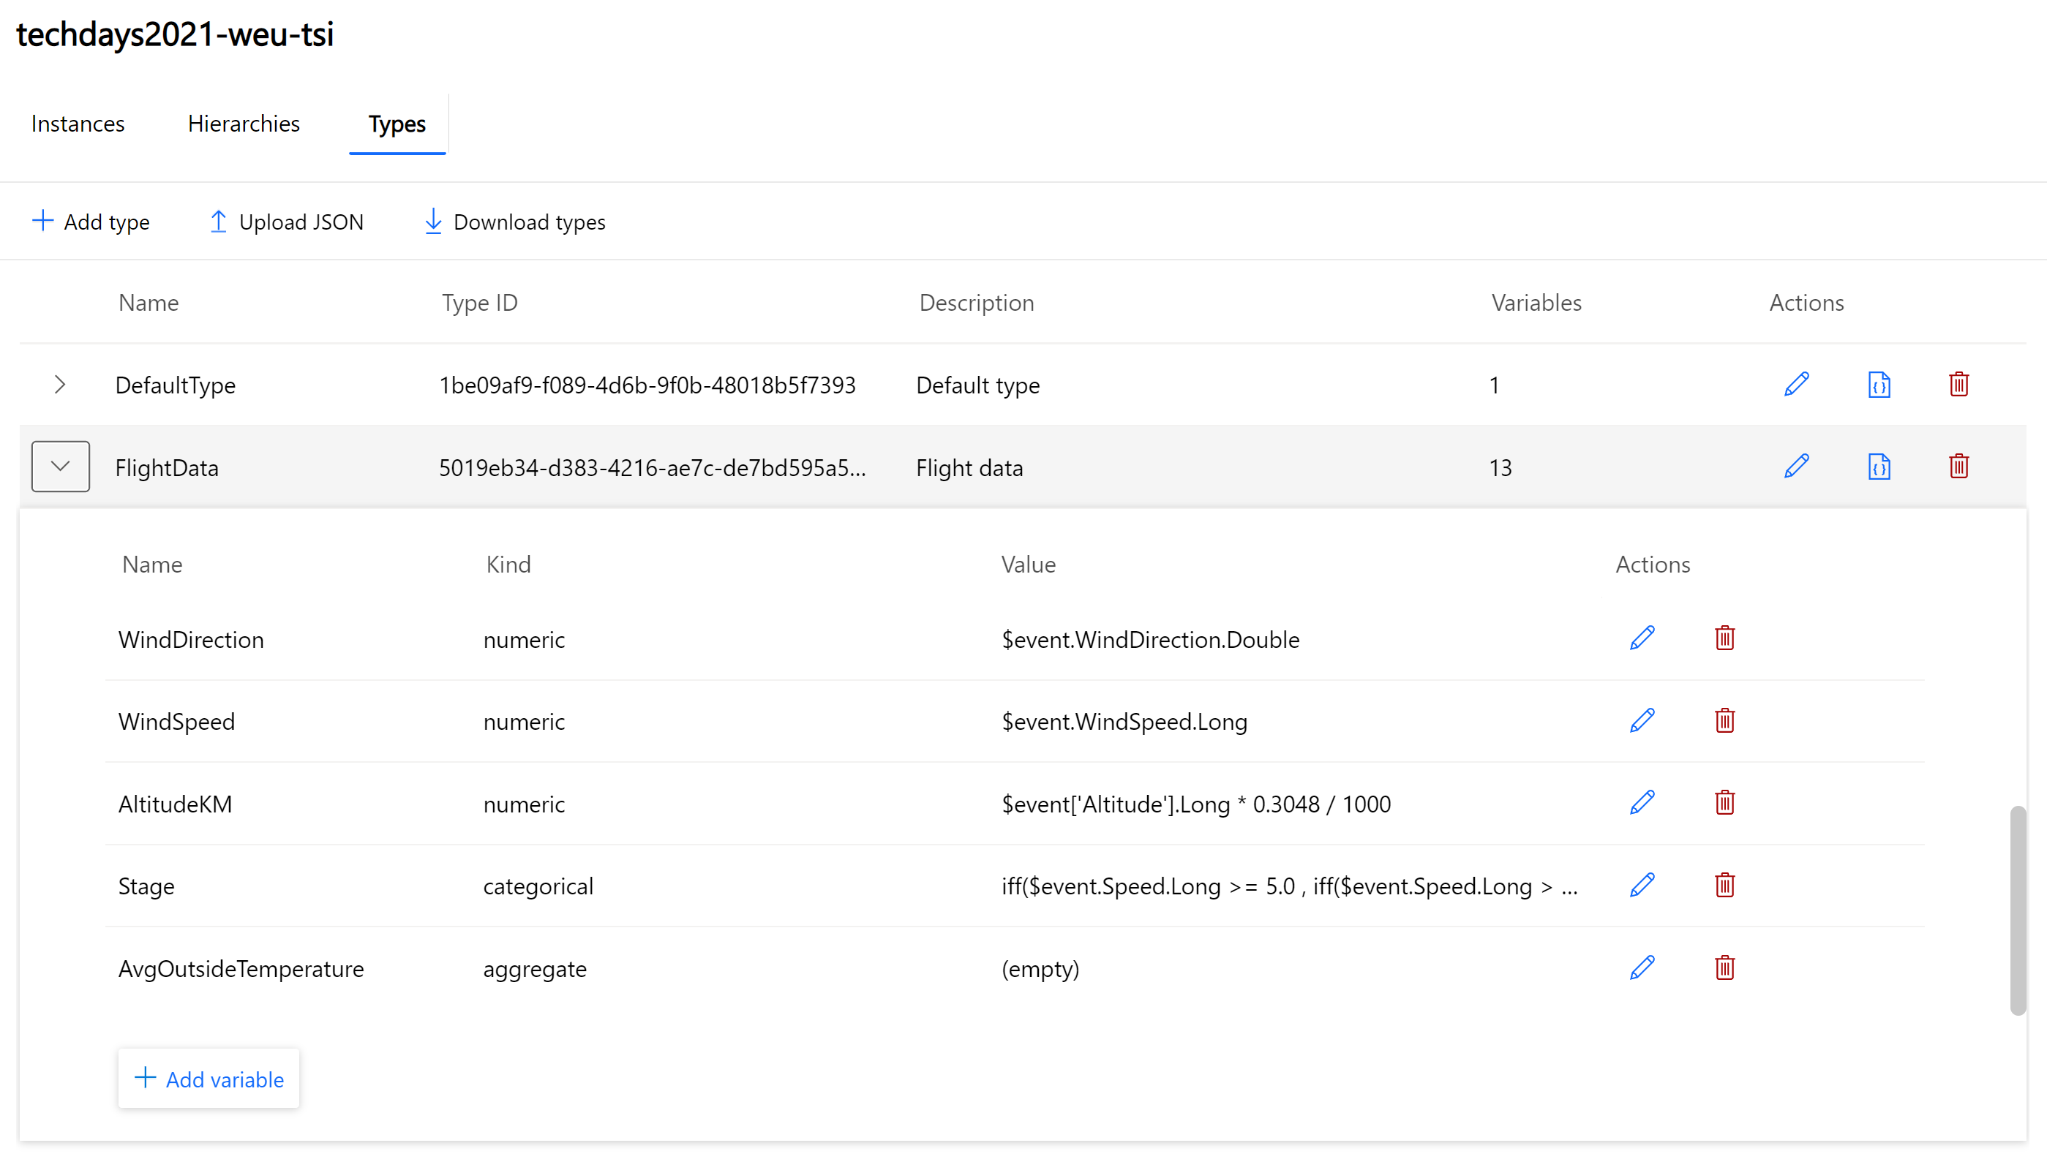
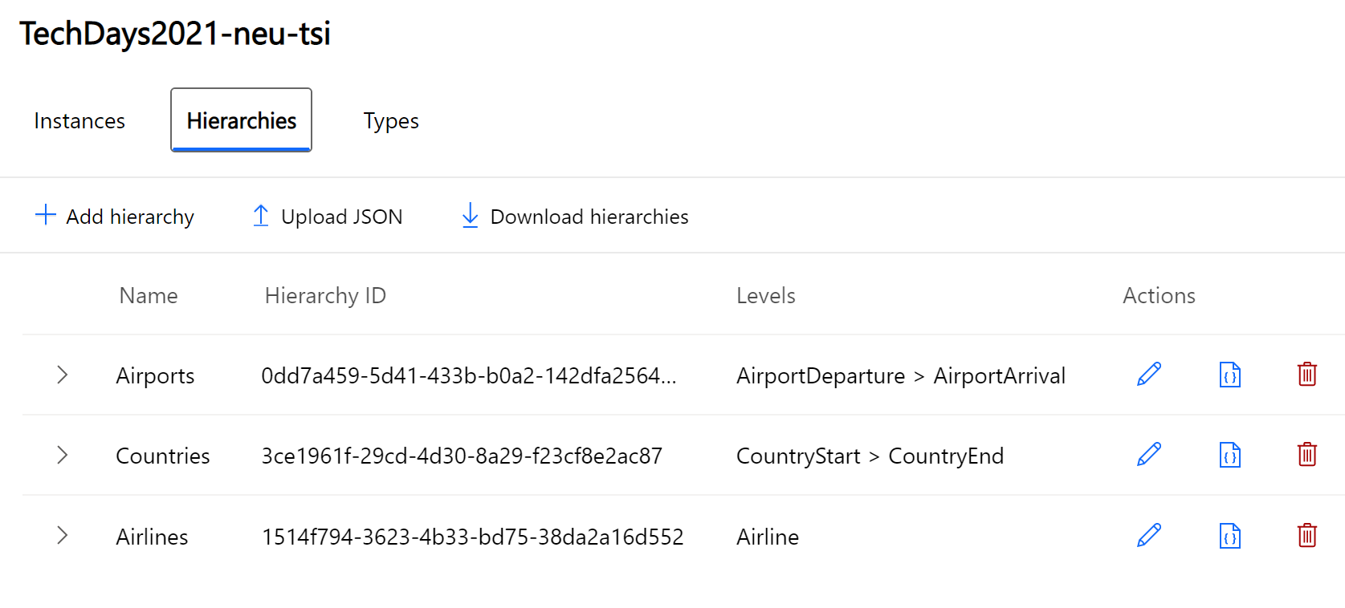
Demo
@svelde

Slide 11
Uncovering the why:
Anomaly detection and diagnosis
3rd Party IoT apps using Time Series Insights APIs
Query API
Time Series Insights JavaScript SDK
IoT device, gateway, and application data
Azure IoT Hub
Time Series Insights
SEEN IN DEMO
Time Series Insights Explorer
SEEN IN DEMO
@svelde

Slide 12















Improving operations:
Stream processing
Operational intelligence and advanced analytics
Operational efficiency
Power
BI
Azure SQL
Azure Logic App
Azure Functions
Real time dashboards
Azure Stream Analytics
Event Hubs
Real time applications
Query API
IoT device, gateway, and application data
Azure IoT Hub
Time Series Insights
Time Series Insights Explorer
Advanced Analytics
Business systems (structured)
Azure Batch
Databricks
Machine Learning
Self serve models
Predictive AI dashboards
Statistical analysis
@svelde

Slide 13
Call to Action
Links with further resources:
Azure IoT Show – Deep Dive
https://channel9.msdn.com/Shows/Internet-of-Things-Show/Deep-Dive-Analyzing-IoT-data-using-Time-Series-Insights
Time Series Insight Documentation
https://docs.microsoft.com/en-us/azure/time-series-insights/
MS Learn module
https://docs.microsoft.com/en-us/learn/modules/explore-analyze-time-series-insights/
AZ 220 Reference
https://docs.microsoft.com/en-us/learn/certifications/exams/az-220
Cloud Skills Challenge - Azure IoT Developer
Cloud Skills Challenge | Azure IoT Developer | Microsoft Learn
Personal blog about IoT, Azure IoT, and Azure IoT Edge
blog.vandevelde-online.com
@svelde

Slide 14
Q&A
Thank you
Sander van de Velde
IoT Solution Architect
Atos
MVP Azure IoT
@svelde
@svelde

